Slide 1
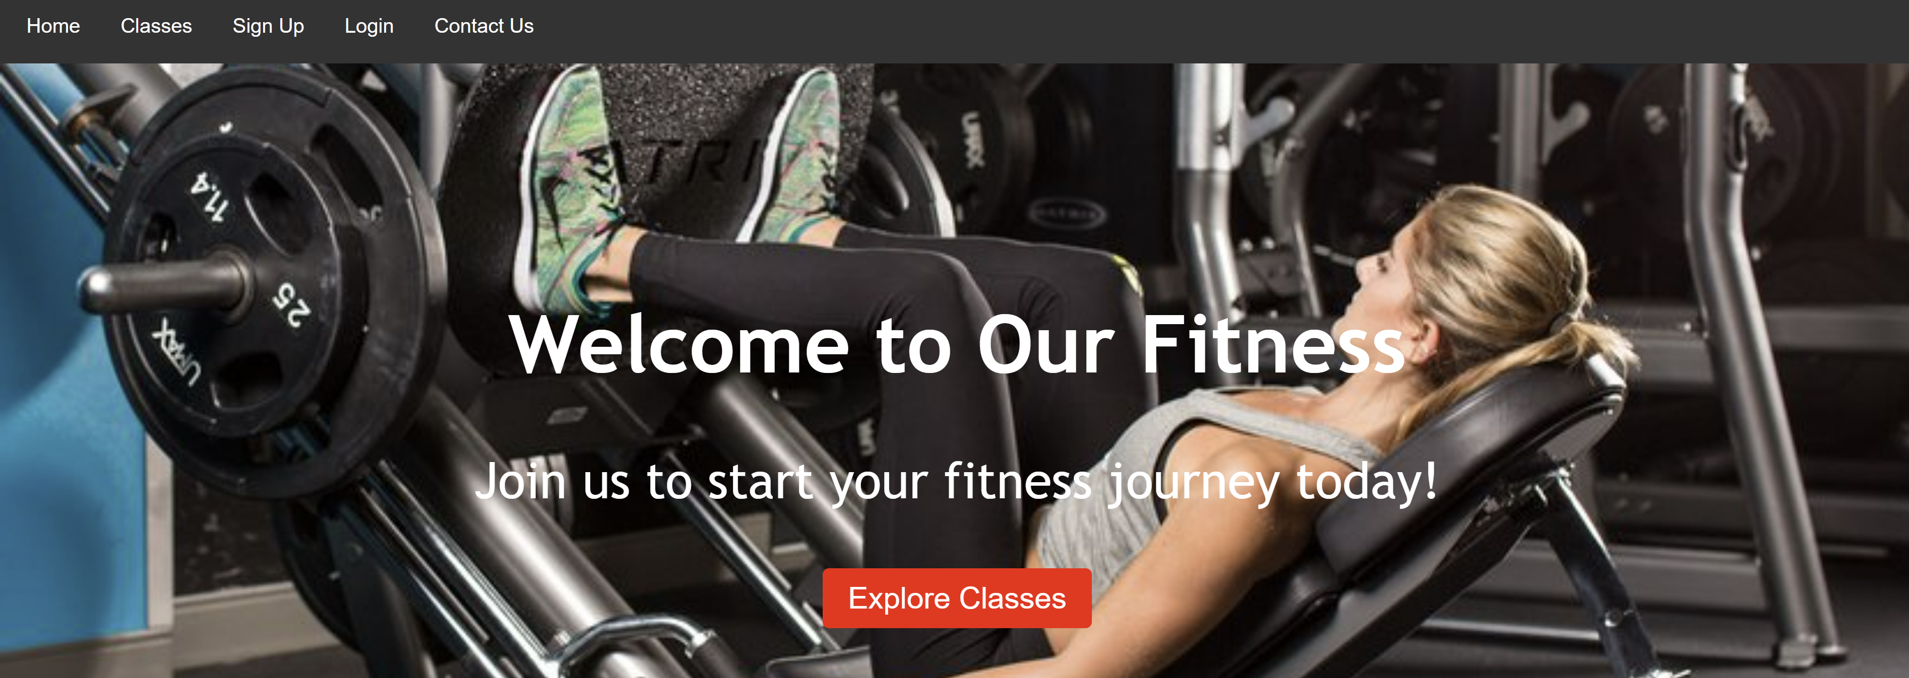
OTTAWA FITNESS
Exercise brings health.
GROUP 15
LISHU YUAN
YUAN TANG
DATE: MAR.27 2024

Slide 2
OTTAWA FITNESS OVERVIEW
Exercise brings health.
Our Goals:
To list featured classes to prospective users.
To allow registered members to book, update, and cancel classes.
To provide a channel for individuals to contact our teams.
Target Group：
Fitness enthusiasts seeking an energized and passionate workout.
Members seeking convenient class scheduling and management options.

Slide 3
TASKS
Exercise brings health.
Designer: Lishu Yuan.
Home and Interactive Pages: Designed for first impressions and user engagement.
Registration/Login Process: Streamlined with real-time JavaScript authentication.
CSS Styling: Consistent modern aesthetic across all page.
PHP Backend: Smooth transitions and secure authentication.

Slide 4
TASKS
Exercise brings health.
Designer: Yuan Tang.
Blueprint: Wireframe, functionally guide and ERD diagram.
Classes: Utilize searches and filters to discover classes.
Database: Use MySQL for efficient user data management.
Data Retrieval: Reservation information is seamlessly displayed for users and administrators.

Slide 5

QUESTIONS?
Exercise brings health.

Slide 6

THANK YOU!
Exercise brings health.

